Slide 1
Community Detection in Graphs
Srinivasan Parthasarathy

Slide 2
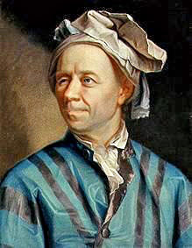
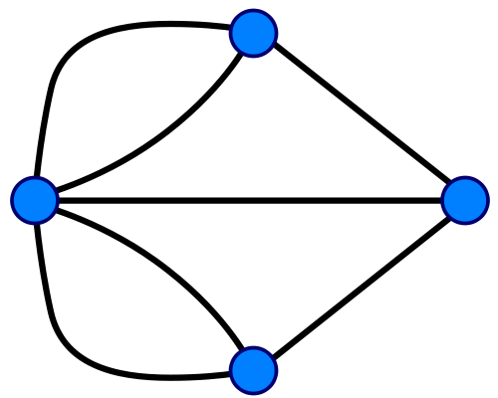
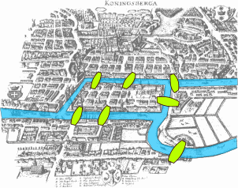
Graphs from the Real World
Königsberg's Bridges
Ref: http://en.wikipedia.org/wiki/Seven_Bridges_of_K%C3%B6nigsberg

Slide 3
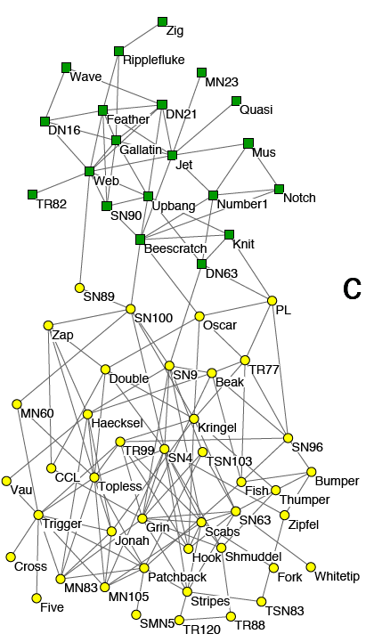
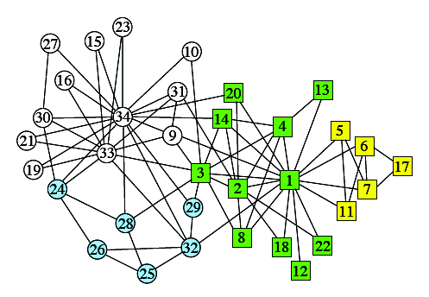
Graphs from the Real World
Zachary’s Karate Club
Lusseau’s network of bottlenose dolphins

Slide 4
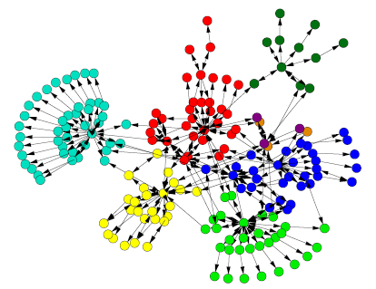
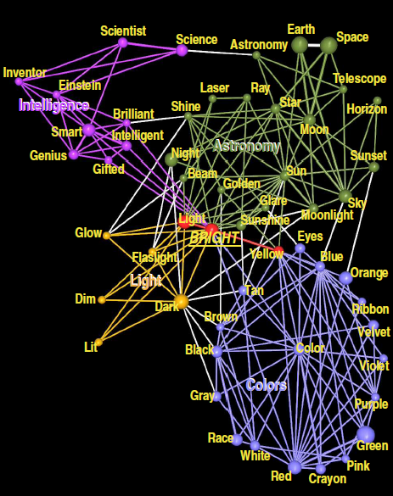
Graphs from the Real Word
Webpage Hyperlink Graph
Directed Communities
Network of Word Associations
Overlapping Communities

Slide 5
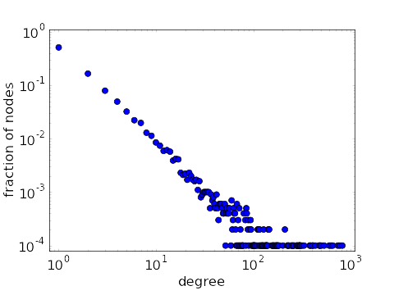
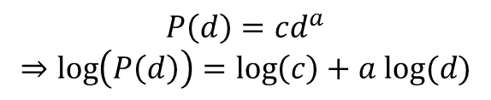
Real Networks Are Not Random
Degree distribution is broad, and often has a tail following power-law distribution
$$P\left(d\right)=cd^{a}$$
$$⇒\log\left(P\left(d\right)\right)=\log\left(c\right)+a log⁡(d)$$
Ref: “Plot of power-law degree distribution on log-log scale.” From Math Insight. http://mathinsight.org/image/power_law_degree_distribution_scatter

Slide 6
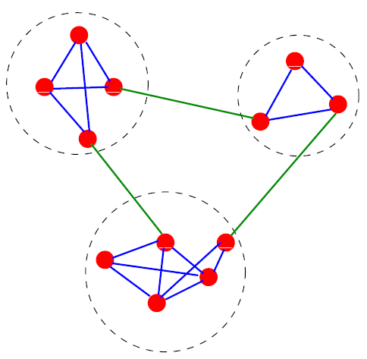
Real Networks Are Not Random
Edge distribution is locally inhomogeneous
Community Structure!

Slide 7
Applications of Community Detection
Website mirror server assignment
Recommendation system
Social network role detection
Functional module in biological networks
Graph coarsening and summarization
Network hierarchy inference

Slide 8
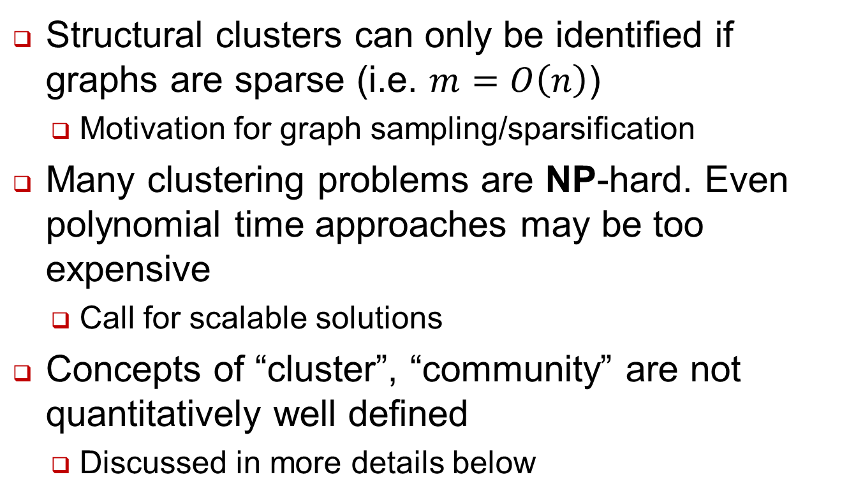
General Challenges
Structural clusters can only be identified if graphs are sparse (i.e. $m=O\left(n\right)$)
Motivation for graph sampling/sparsification
Many clustering problems are NP-hard. Even polynomial time approaches may be too expensive
Call for scalable solutions
Concepts of “cluster”, “community” are not quantitatively well defined
Discussed in more details below

Slide 9
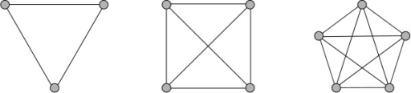
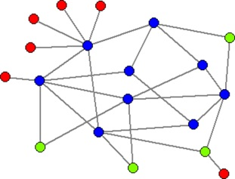
Defining Motifs (Micro communities)
Local definitions: focus on the subgraph only
Clique: Vertices are all adjacent to each other
Strict definition, NP-complete problem
n-clique, n-clan, n-club, k-plex
k-core: Maximal subgraph that each vertex is adjacent to at least k other vertices in the subgraph
More advanced motifs – graphlets, k-truss etc.

Slide 10
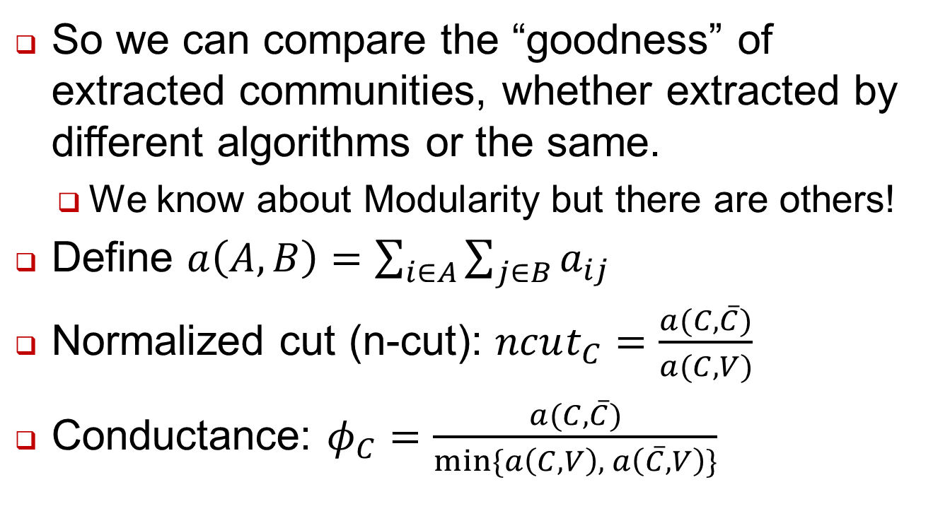
Evaluating Community Quality
So we can compare the “goodness” of extracted communities, whether extracted by different algorithms or the same.
We know about Modularity but there are others!
Define $a\left(A, B\right)=\sum_{i∈A}{\sum_{j∈B}{a_{ij}}}$
Normalized cut (n-cut): $ncut_{C}=\frac{a(C, \overline{C})}{a(C, V)}$
Conductance: $φ_{C}=\frac{a(C, \overline{C})}{min⁡\{a\left(C, V\right), a\left(\overline{C}, V\right)\}}$

Slide 11
Traditional Methods
Graph Partitioning
Dividing vertices into groups of predefined size
Kernighan-Lin algorithm
Create initial bisection
Iteratively swap subsets containing equal number of vertices
Select the partition that maximize (number of edges insider modules – cut size)

Slide 12
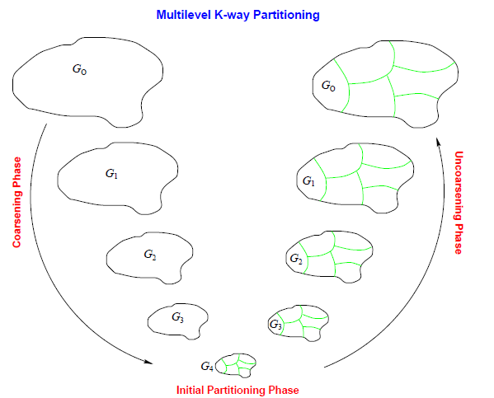
Traditional Methods (Sec. 4)
Graph Partitioning
METIS (Karypis and Kumar)
Multi-level approach
Coarsen the graph into skeleton
Perform K-L and other heuristics on the skeleton
Project back with local refinement

Slide 13
Metis
Multilevel
Use short range and long range structure
3 major phases
coarsening
initial partitioning
refinement
G₁
…
…
coarsening
refinement
…
…
G_{n}
initial partitioning

Slide 14
Coarsening
Find matching
related problems:
maximum (weighted) matching (O(V^{1/2}E))
minimum maximal matching (NP-hard), i.e., matching with smallest #edges
polynomial 2-approximations

Slide 15
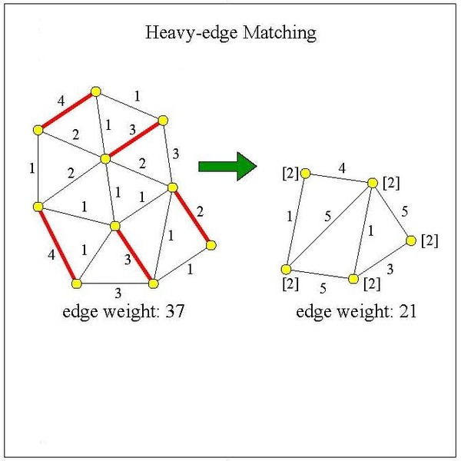
HEM: Example

Slide 16
Coarsening
Edge contract
a
b
*
c
c

Slide 17
Initial Partitioning
Breadth-first traversal
select k random nodes
b
a

Slide 18
Initial Partitioning
Kernighan-Lin
improve partitioning by greedy swaps
c
D_{c} = E_{c} – I_{c} = 3 – 0 = 3
d
D_{d} = E_{d} – I_{d} = 3 – 0 = 3
Benefit(swap(c, d)) = D_{c} + D_{d} – 2A_{cd} = 3 + 3 – 2 = 4
c
d

Slide 19
Refinement
a
Random K-way refinement
Randomly pick boundary node
Find new partition which reduces graph cut and maintains balance
Repeat until all boundary nodes have been visited
a

Slide 20
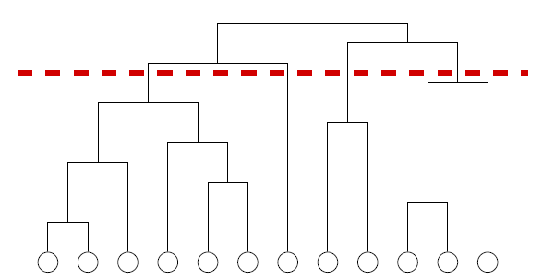
Hierarchical Clustering
Hierarchical Clustering
Graphs may have hierarchical structure
Embed vertices in a metric space and then cluster

Slide 21
Hierarchical Clustering
Hierarchical Clustering
Find clusters using a similarity matrix
Agglomerative: clusters are iteratively merged if their similarity is sufficiently high
Divisive: clusters are iteratively split by removing edges with low similarity
Define similarity between clusters
Single linkage (minimum element)
Complete linkage (maximum element)
Average linkage
Drawback: dependent on similarity threshold

Slide 22
Other Methods
Partitional Clustering
Embed vertices in a metric space, and find clustering that optimizes the cost function
Minimum k-clustering
k-clustering sum
k-center
k-median
k-means
Fuzzy k-means
DBSCAN

Slide 23
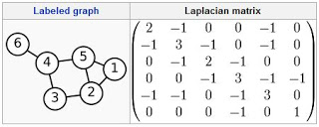
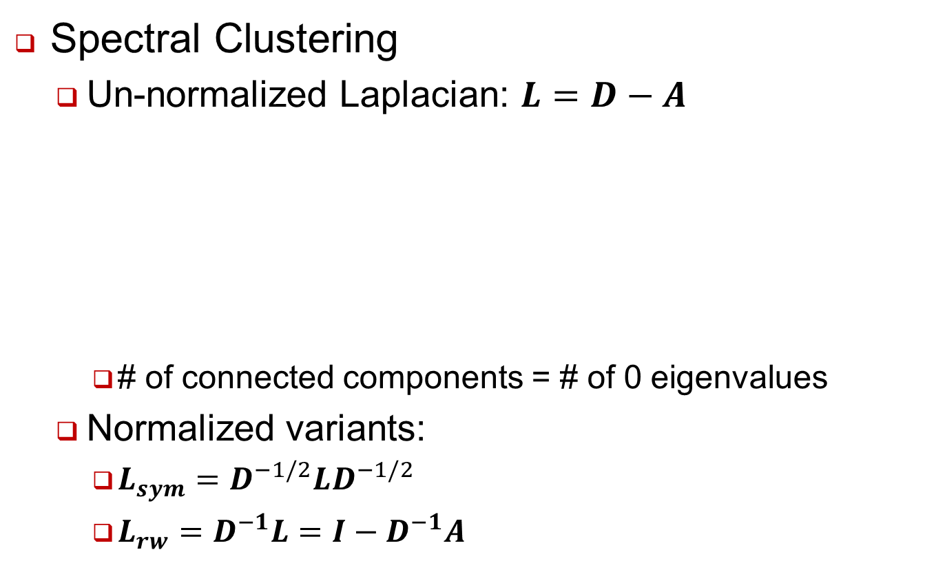
SPECTRAL CLUSTERING
Spectral Clustering
Un-normalized Laplacian: $L=D−A$
# of connected components = # of 0 eigenvalues
Normalized variants:
$L_{sym}=D^{−1/2}LD^{−1/2}$
$L_{rw}=D^{−1}L=I−D^{−1}A$

Slide 24
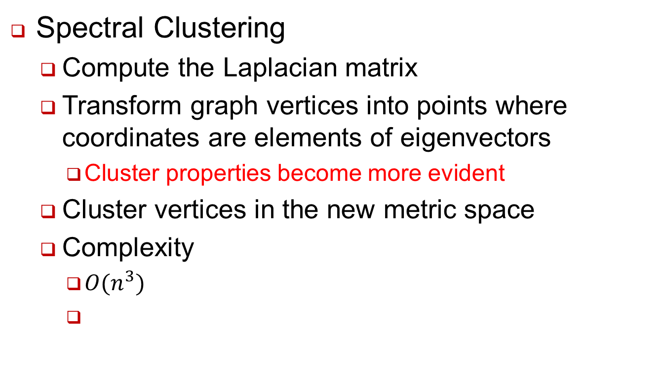
Spectral Clustering
Spectral Clustering
Compute the Laplacian matrix
Transform graph vertices into points where coordinates are elements of eigenvectors
Cluster properties become more evident
Cluster vertices in the new metric space
Complexity
$O(n^{3})$

Slide 25
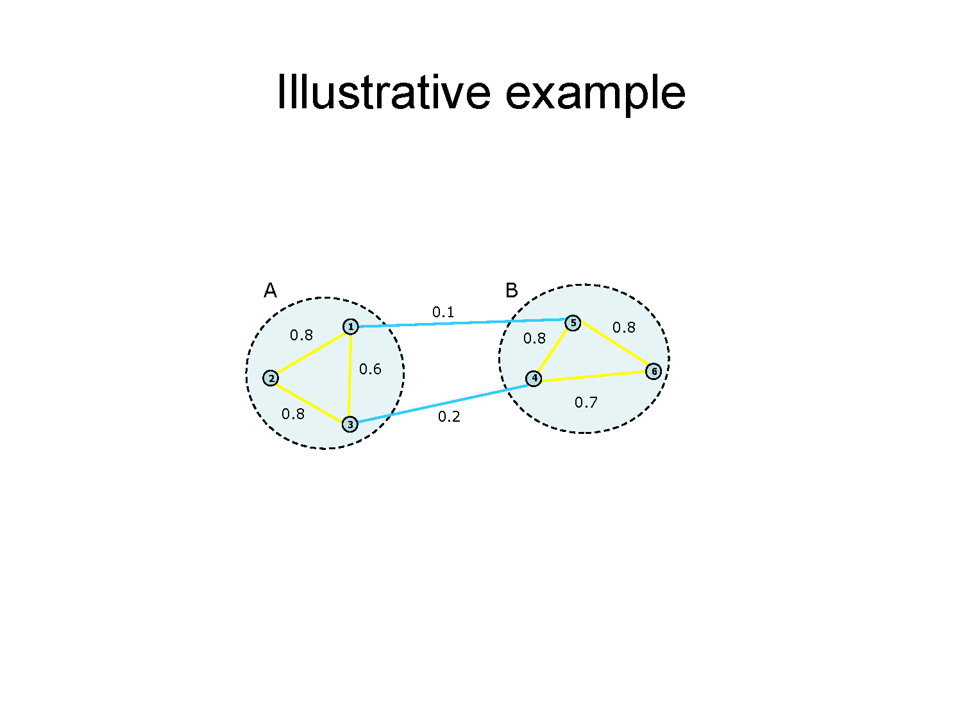

Slide 26
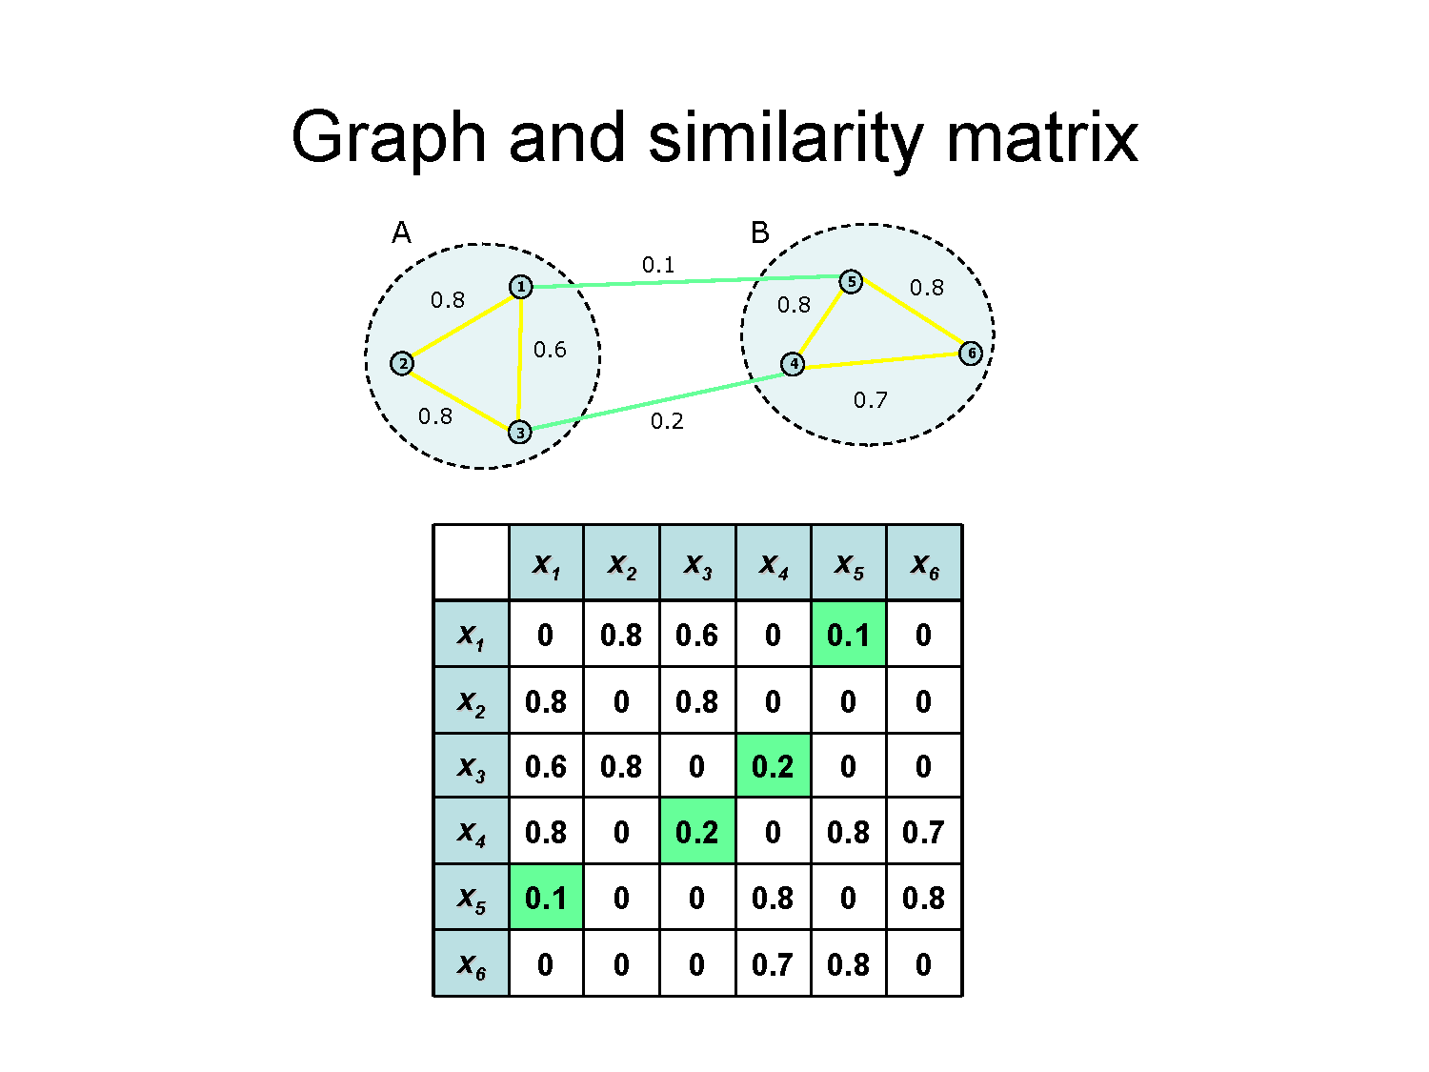

Slide 27
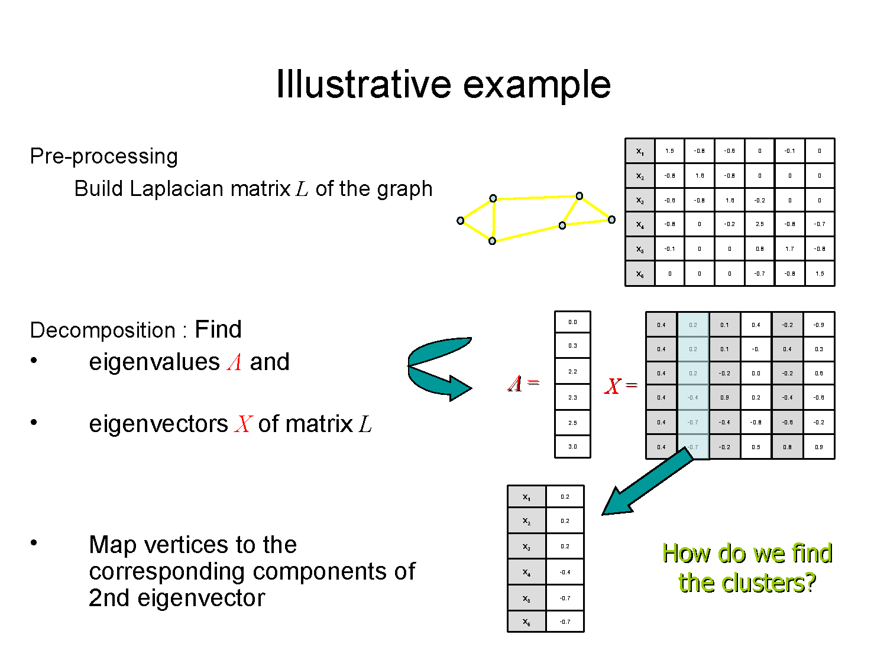

Slide 28
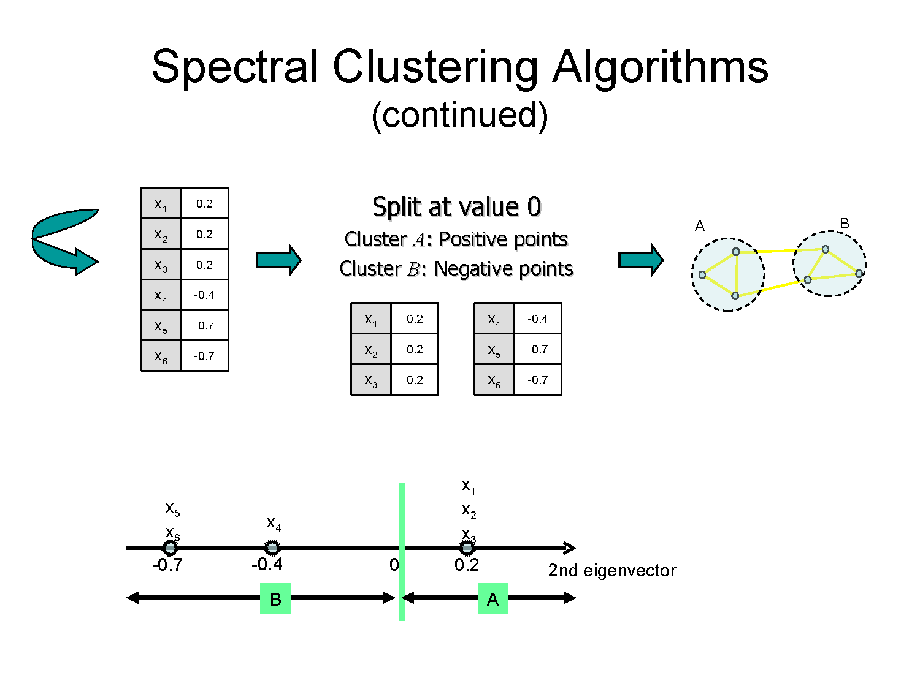

Slide 29
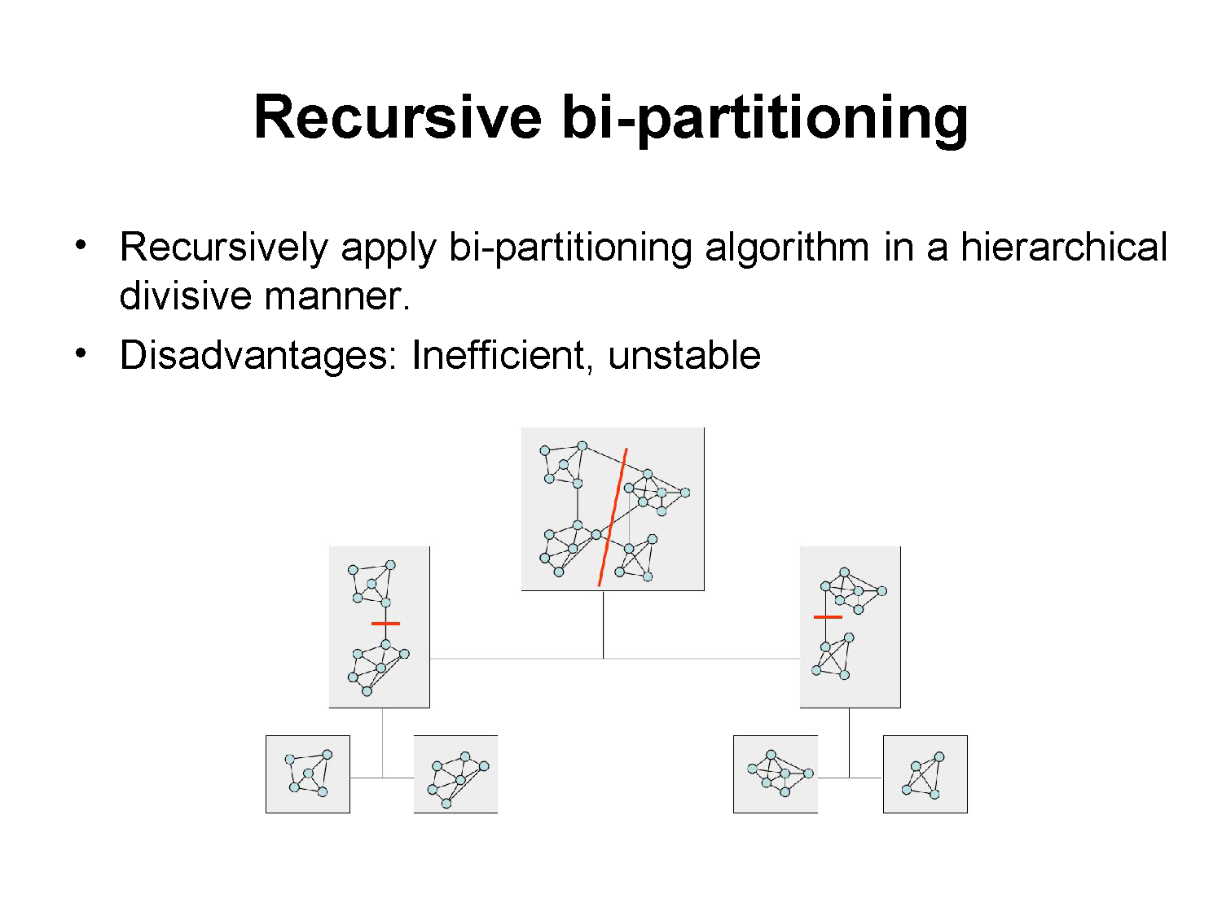

Slide 30
Alternative Approach
Compute Laplacian as before
Compute representation of each point to low rank representation by selecting several eigenvectors up to the desired inertia
Inertia ←→ Total variance explained by low rank approximation
Run k-means or any clustering algorithm on representation

Slide 31
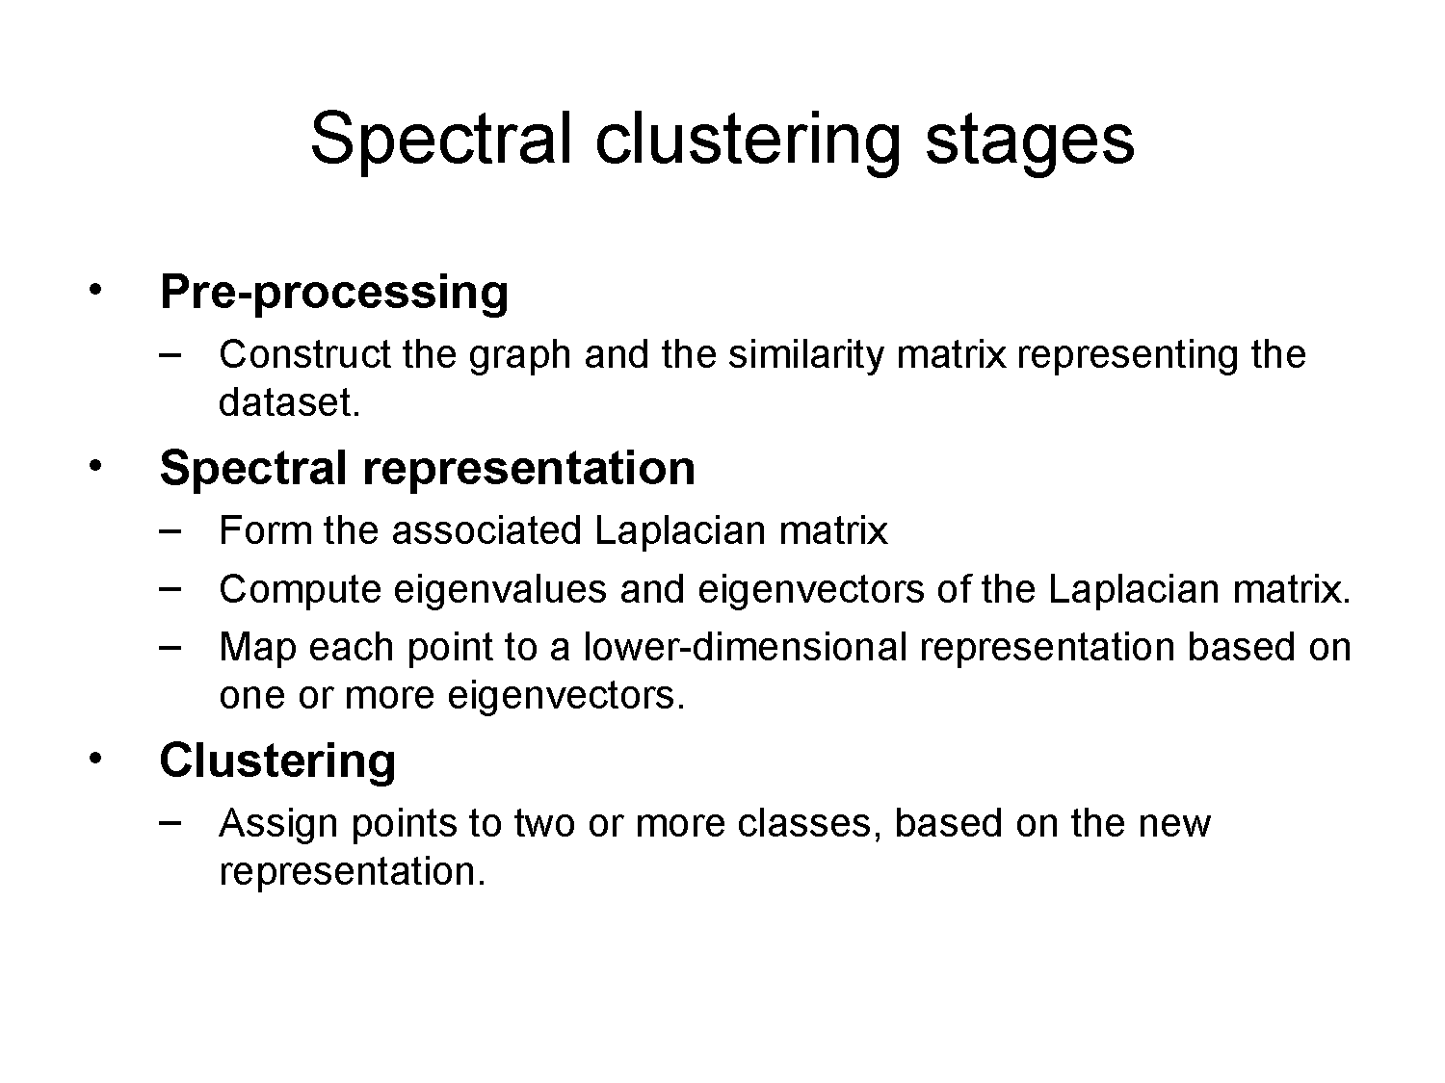

Slide 32
Variants of Betweenness
Girvan and Newman’s edge centrality algorithm: Iteratively remove edges with high centrality and re-compute the values
Define edge centrality:
Edge betweenness: number of all-pair shortest paths that run along an edge
Random-walk betweenness: probability of random walker passing the edge
Current-flow betweenness: current passing the edge in a unit resistance network

Slide 33
Random Walk Based Approaches
A random walker spends a long time inside a community due to the high density of internal edges
E.g. 1 : Zhou used random walks to dene a distance between pairs of vertices
the distance between i and j is the average number of edges that a random walker has to cross to reach j starting from i.

Slide 34
Stochastic (Flow) Matrix: A matrix where each column sums to 1.
Stochastic Flow: An entry in a stochastic matrix, interpreted as the “flow” or “transition probability”.
1
2
 | 1 | 2 | 3 | 4
1 |  | 0.33 |  | 0.5
2 | 0.5 |  | 1.0 | 0.5
3 |  | 0.33
4 | 0.5 | 0.33
3
4
Notes:
A matrix in which each column sums to 1; essentially each column can be interepreted as a probablity distirbution. We can associate graphs with stochastic matrices by taking the input adjacency matrix of the graph, and re-scaling each column such that it sums to 1. We can interpret such a matrix as follows: the ith entry in the jth column gives us the transition probability of moving from j to i in one step. We call this the stochastic flow from j to i.

Slide 35
Stochastic (Flow) Matrix: A matrix where each column sums to 1.
Stochastic Flow: An entry in a stochastic matrix, interpreted as the “flow” or “transition probability”.
1
2
 | 1 | 2 | 3 | 4
1 | 0.33 | 0.25 |  | 0.33
2 | 0.33 | 0.25 | 0.5 | 0.33
3 |  | 0.25 | 0.5
4 | 0.33 | 0.25 |  | 0.33
3
4
Notes:
Add self loops.

Slide 36
Stochastic (Flow) Matrix: A matrix where each column sums to 1.
Stochastic Flow: An entry in a stochastic matrix, interpreted as the “flow” or “transition probability”.
1
2
 | 1 | 2 | 3 | 4
1 | 0.33 | 0.25 |  | 0.33
2 | 0.33 | 0.25 | 0.5 | 0.33
3 |  | 0.25 | 0.5
4 | 0.33 | 0.25 |  | 0.33
3
4
Flow from 2 to 3

Slide 37
Stochastic (Flow) Matrix: A matrix where each column sums to 1.
Stochastic Flow: An entry in a stochastic matrix, interpreted as the “flow” or “transition probability”.
1
2
 | 1 | 2 | 3 | 4
1 |  | 0.33 |  | 0.5
2 | 0.5 |  | 1.0 | 0.5
3 |  | 0.33
4 | 0.5 | 0.33
3
4
Flow from 2 to 3

Slide 38
Stochastic (Flow) Matrix: A matrix where each column sums to 1.
Stochastic Flow: An entry in a stochastic matrix, interpreted as the “flow” or “transition probability”.
1
2
 | 1 | 2 | 3 | 4
1 |  | 0.33 |  | 0.5
2 | 0.5 |  | 1.0 | 0.5
3 |  | 0.33
4 | 0.5 | 0.33
3
In-flows of 2
4
Out-flows of 2

Slide 39
Stochastic (Flow) Matrix: A matrix where each column sums to 1.
Stochastic Flow: An entry in a stochastic matrix, interpreted as the “flow” or “transition probability”.
1
2
 | 1 | 2 | 3 | 4
1 | 0.33 | 0.25 |  | 0.33
2 | 0.33 | 0.25 | 0.5 | 0.33
3 |  | 0.25 | 0.5
4 | 0.33 | 0.25 |  | 0.33
3
In-flows of 2
4
Out-flows of 2

Slide 40
Repeatedly apply certain operations to the flow matrix until the matrix converges and can be interpreted as a clustering.
1
2
 | 1 | 2 | 3 | 4
1
2 | 1.0 | 1.0 |  | 1.0
3 |  |  | 1.0
4
3
4

Slide 41
Markov Clustering (MCL)
Stijn van Dongen, 2000
The original Stochastic flow clustering algorithm

Slide 42
The MCL algorithm
Create initial flow matrix M from input
Expand flow out to new, well-connected nodes.
Expand
M := M * M
Inflate
M := M.^r (r > 1)
Prune
Raise each entry to the power r. Increase inequality in each column.
Remove entries in matrix close to zero.
Converged?
No
Yes
Output Clusters

Slide 43
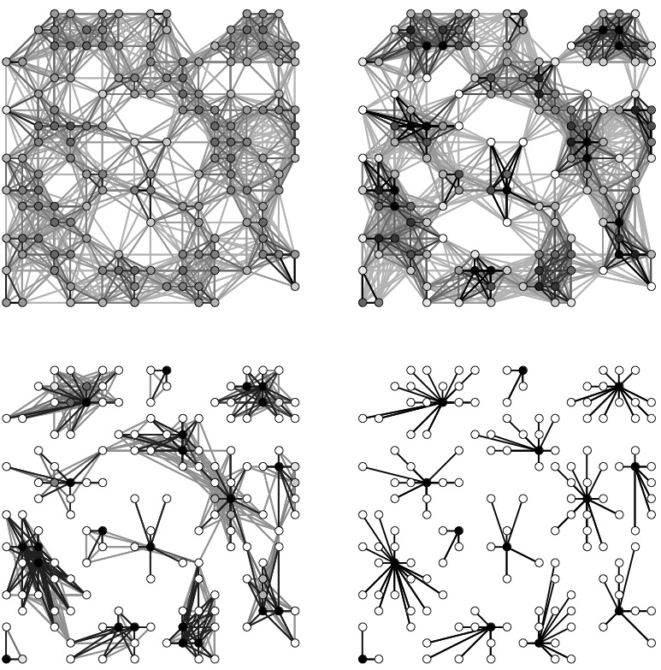
[van Dongen ’00]
Notes:
Add color.

Slide 44
MCL Flaws
1. Outputs many small clusters.
2. Does not scale well.
[Chakrabarti and Faloutsos ‘06]
Notes:
Provide more details.

Slide 45
MCL Flaws
1. Outputs many small clusters.
Fix: Regularized MCL
2. Does not scale well.
Fix: Multi-Level Regularized MCL

Slide 46

The Regularize operator
Key idea: Set the out-flows of a node such that it is minimally different from its neighbors.
Weight of neighbor j
KL-Divergence of q w.r.t. neighbor j
Weight matrix W constructed from adjacency structure of the input graph.

Slide 47

The Regularize operator
Key idea: Set the out-flows of a node so as to minimize “distance” from neighbors. Distance measured using KL-divergence.
Closed-form solution!
Weight of neighbor j
In matrix notation,

Slide 48
The Regularize operator
Closed-form solution when W itself is a stochastic matrix!
In matrix notation,

Slide 49
The R-MCL algorithm
Create initial flow matrix M from input
Take into account out-flows of neighbors.
Regularize
M := W * M
Inflate
M := M.^r (r > 1)
Prune
Raise each entry to the power r. Increase inequality in each column.
Remove entries in matrix close to zero.
Converged?
No
Yes
Output Clusters

Slide 50
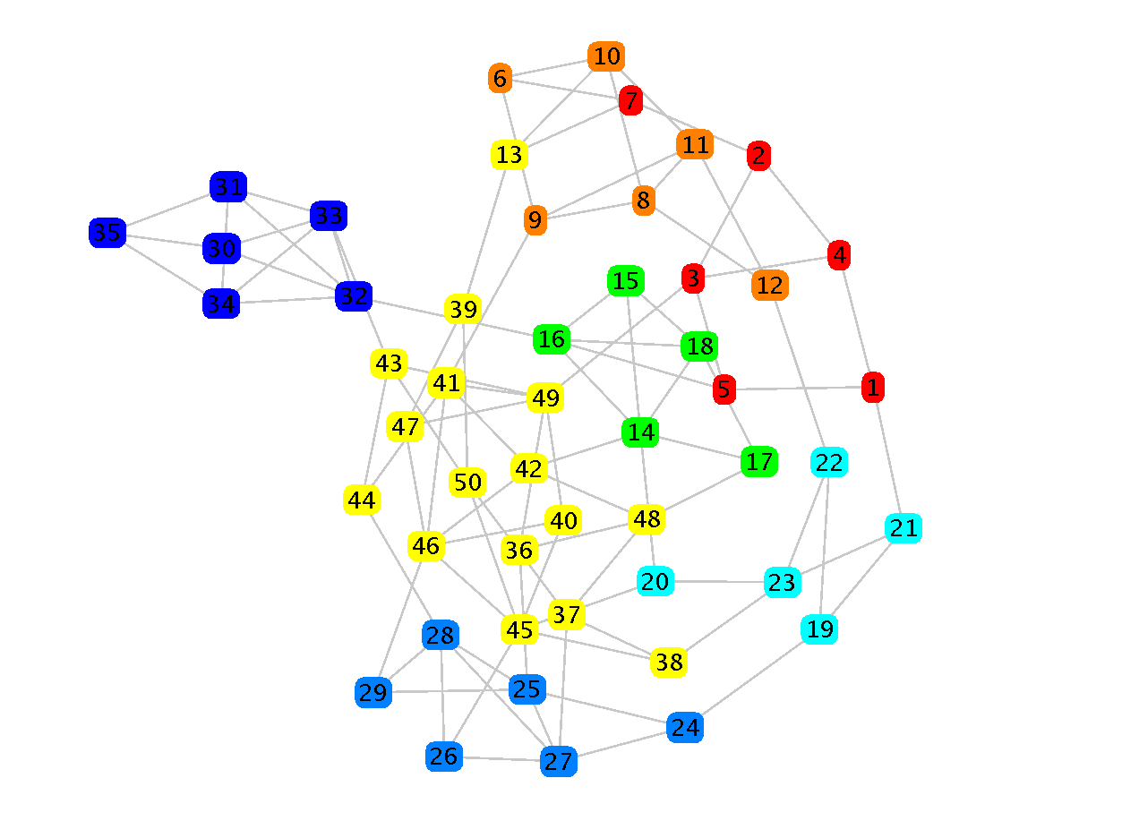
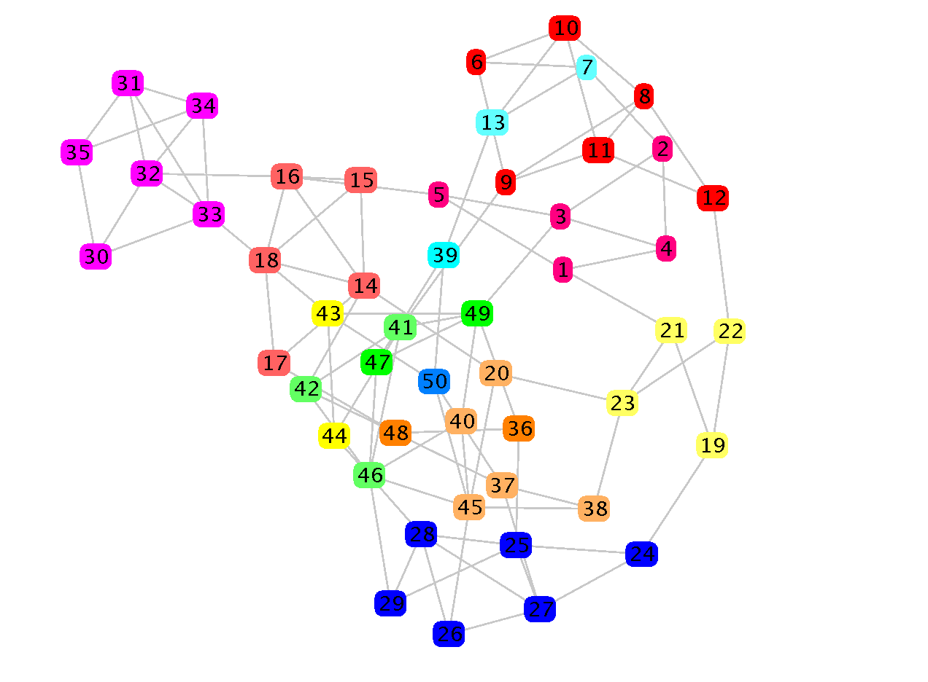
MCL
R-MCL
[Automtically visualized using Prefuse]

Slide 51
Multi-Level Regularized MCL
Making R-MCL fast

Slide 52
General idea of multi-level methods:
Create smaller “replicas” of the original problem.
Solving the smaller problem should help us solve the original problem.
[Shang-hua Teng ’97]

Slide 53
“Coarsening”: Creating smaller replicas
Input
Graph
1
3
2
4
5
Coarsened
Graph
1
2
2
1
3
[Karypis and Kumar ’98]

Slide 54
Output clusters
Input Graph
Input Graph
Run R-MCL,
Uncoarsen,
Initalize bigger flow matrix
Coarsen
...
Captures global graph topology!
Coarsest
Graph
Faster to run on smaller graphs first!

Slide 55
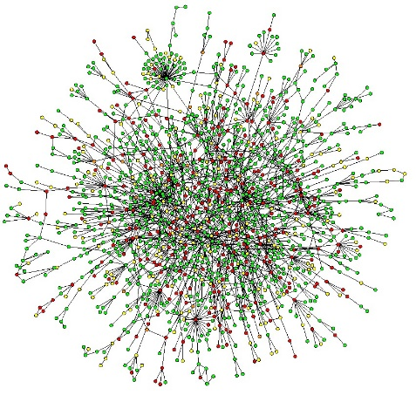
Comparison with MCL on
Protein Interaction Networks
Dataset (n,m) | Quality Change | Speedup (Time)
Yeast (5k, 15k) | 36% | 2.5x (0.4s)
Yeast_Noisy (6k, 200k) | 300% | 57x (8s)
Human (10k, 60k) | 21.6% | 200x (2s)
[Hardware: Quad-core Intel i5 CPU, 3.2 GHz, with 16GB RAM ]

Slide 56
Yeast Protein Interaction Network
~5000 nodes, ~16000 edges
 | Accuracy (F-Score) | Time (s)
MLR-MCL | 25.1 | 0.4
MCL | 18.4 | 1.0
Spectral | 24.8 | 300.0
Kernel K-Means | 22.4 | 0.2
Metis | 21.2 | 0.3
Metis+MQI | 23.3 | 0.3

Slide 57

20-Newsgroups text documents
~20k documents
 | Accuracy (F-Score) | Time (s)
MLR-MCL | 61.4 | 3.1
MCL | 40.6 | 635.4
Spectral | 53.0 | 4.7
Kernel K-Means | 35.0 | 0.2
Metis | 52.8 | 0.3
Metis+MQI | 61.7 | 2.9
Notes:
normalize the accuracy scores. talk about systems-y stuff here.

Slide 58

Wikipedia article-article network
~1.1M nodes, ~53M edges
 | Quality (Absolute) | Time (minutes)
MLR-MCL | 20.2 | 132
Metis | 12.3 | 125
Metis+MQI | 19.2 | 592
Note: MCL and other methods timed-out or ran out of memory.
[Hardware: Quad-core Intel i5 CPU, 3.2 GHz, with 16GB RAM ]

Slide 59

Real World Impact
“
....
....
”

Slide 60
Overlapping community detection
Most of previous methods can only generate non-overlapped clusters.
A node only belongs to one community.
Not real in many scenarios.
A person usually belongs to multiple communities.
Most of current overlapping community detection algorithms can be categorized into three groups.
Mainly based on non-overlapping communities algorithms.

Slide 61
Overlapping community detection
1. Identifying bridge nodes
First, identifying bridge nodes and remove or duplicate these nodes.
Duplicate nodes have connection b/t them.
Then, apply hard clustering algorithm.
If bridge nodes was removed, add them back.
E.g. DECAFF [Li2007], Peacock [Gregory2009]
Cons: Only a small part of nodes can be identified as bridge nodes.
2
5
1
4
3
6
Notes:
cons: but actually, a large amount of proteins are multi-functional

Slide 62
Overlapping community detection
2. Line graph transformation
Edges become nodes.
New nodes have connection if they originally share a node.
Then, apply hard clustering algorithm on the line graph.
E.g. LinkCommunity [Ahn2010]
Cons: An edge can only belong to one cluster
1
2
4
6
5
1
4
3
8
2
3
7
6
5
Notes:
3. cons: given the PPI networks are usually very noisy.

Slide 63
Overlapping community detection
3. Local clustering
(optional) Select seed nodes.
Expand seed node according to some criterion.
E.g. ClusterOne [Nepusz2012], MCODE [Bader2003], CPM [Adamcsek2006], RRW [Macropol2009]
Cons: Not globally consider the topology
2
5
1
4
3
6

Slide 64
Dynamic community
Cluster each snapshot independently
Then mapping clusters in each clustering.
If two clusters in continuous snapshots share most of nodes, then the next one evolves from the previous one.
Detect the evolution of communities in a dynamic graph.
Birth, Death, Growth, Contraction, Merge, Split.

Slide 65
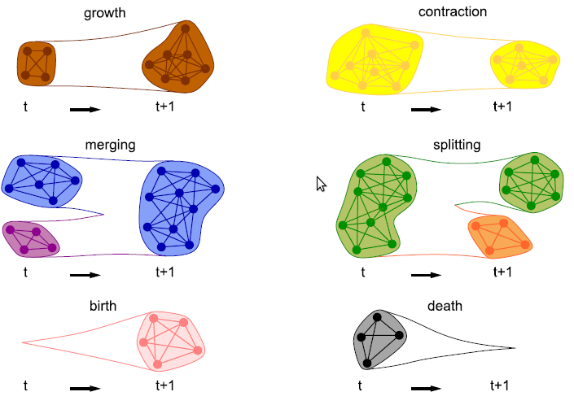
Dynamic community

Slide 66
Dynamic community
Asur et al. (2007) further detect a event involving nodes.
E.g. join and leave
Measure the node behavior.
Sociability: How frequently a node join and leave a community.
Influence: How a node can influence other nodes’ activities.
Usage
Understand the community behavior.
E.g. age is positively correlated with the size.
Predict the evolution of a community
Predict node (user) behavior, predict link

Slide 67
Dynamic community detection
Hypothesis: Communities in dynamic graphs are “smooth”.
Detect communities by also considering the previous snapshots.
Chakrabarti et al (2006) introduce history cost.
Measures the dissimilarity between two clusterings in continuous timestamps.
A smooth clustering has lower history cost.
Add this cost to the objective function.

Slide 68
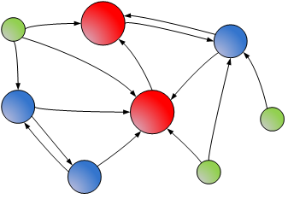
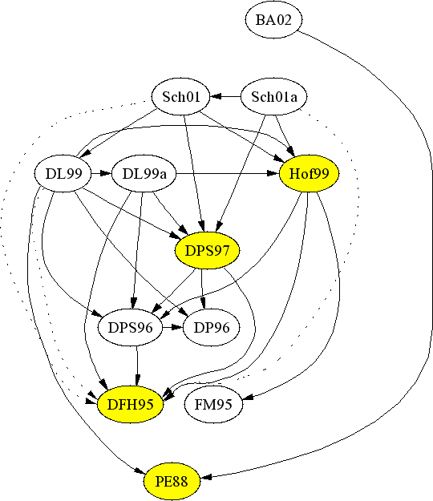





COMMUNITY DISCOVERY IN DIRECTED GRAPHS
Research on graph clustering is mostly focused on undirected graphs, yet the graphs from a number of domains are directed in nature.
Web graphs
Citation networks
Twitter (follower) network
Undirected edges indicate similarity/affinity while directed edges need not indicate similarity.
It is important to recognize this difference when clustering.

Slide 69
Existing research
Objective functions such as normalized cuts, originally meant for undirected graphs, have been extended to directed graphs [Zhou et al. ’05, Huang et al. ‘06, Meila ‘07]
The Ncut (normalized cut) of a cluster S is the probability of a random walk escaping from S to the rest of the graph , or vice versa.
Clusters with low Ncut are found by spectral methods i.e. by post-processing
the eigenvectors of the directed Laplacian of the graph.

Slide 70
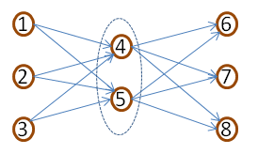
Drawbacks of Existing Research
Existing measures are biased to find groups of nodes with high
inter-connectivity.
However, directed networks often contain clusters which need
not be well inter-connected in the original graph!
Example: Nodes 4 and 5 form a cluster, even though they are not connected to one another.
Real-life analogue: Research papers written
on the same topic in a short span of time may
not be able to cite one another but may cite
(and be cited by) a common set of papers.

Slide 71
Our Framework
Symmetrizations
Existing
A+A^{T}
Random walk
Proposed
Bibliometric
Degree -discounted
Clustering
Algorithms
MLR-MCL
Metis
Graclus
Spectral
Directed Graph
(Weighted)
Undirected
Graph
Clusters
By “Symmetrizations”, we mean procedures for transforming a directed graph into an undirected graph.

Slide 72
Why a two-stage framework?
Why convert to an undirected graph, and then cluster the undirected graph?
Three reasons:
Our framework makes the underlying similarity assumptions explicit.
Flexibility: prior methods which directly cluster directed graphs can be re-expressed in our framework.
Decouples similarity measure and clustering algorithm, thereby allows use of latest and most suitable clustering algorithms.

Slide 73
Existing symmetrizations
Let the adjacency matrix of the input directed graph be A.
A+A^{T} symmetrization :
Corresponds to ignoring directionality.
Implicit symmetrization that is used widely.
Random Walk symmetrization:
The directed graph G can be converted into an undirected graph G_{U} so that the normalized cut on G_{U} is equal to the normalized cut on G. [Gleich ‘06]
P is the Markov transition matrix, and Π is a diagonal matrix with the stationary distribution (PageRank) on the diagonal.
Clustering G_{U} is equivalent to the algorithms proposed by [Zhou ‘05, Huang ’06]

Slide 74
Proposed symmetrizations - Bibliometric
Our Approach: Design a suitable similarity measure for pairs of vertices, and set the edge weight between a pair of vertices in the symmetrized graph to be their similarity.
Axioms for similarity:
Axiom 1: Vertices are similar if they point to or are pointed at by common
vertices.
Similarity(i,j) = No. of shared in-links + No. of shared out-links
Symmetrized graph
G_{U} = A^{T}A + AA^{T}
We call this Bibliometric symmetrization (for historic reasons)

Slide 75
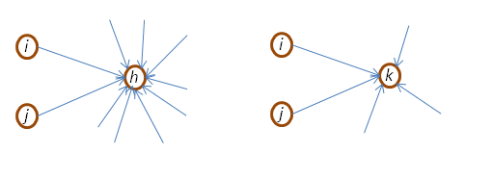
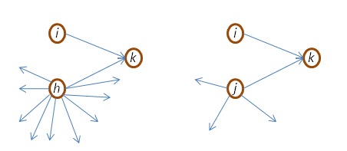
Proposed Symmetrizations - Degree-discounted
Disadvantage of Bibliometric: Hub nodes can have spuriously high similarity with a lot of nodes.
We propose Degree-discounted similarity incorporating the below axioms also:
Axiom 2: Commonly pointing to nodes with high in-degree counts for less than pointing to nodes with low in-degree.
Axiom 3: Being pointed at by nodes with high out-degree counts for less than being pointed at by nodes with low out-degree.

Slide 76
Proposed Symmetrizations - Degree-discounted
A – Adjacency matrix of input directed graph
D_{o} – Diagonal matrix with out-degrees, D_{i} – Diagonal matrix with in-degrees
Degree-discounted out-link similarity O_{d} between i and j:
α and β are the degree-discounting exponents.
Similarly, degree-discounted in-link similarity I_{d} can be derived as:
Final degree-discounted similarity matrix:
We found α=β=0.5 to work best empirically (similar to L2-normalization).

Slide 77
Pruning Thresholds
For Bibliometric & Degree-discounted, it is critical to prune the symmetrized matrix i.e. remove edges below a threshold.
Two reasons:
The full symmetrized matrix is very dense and is difficult to both compute, as well as cluster subsequently.
The symmetrization itself can be computed much faster if we only want entries above a certain threshold
Large literature on speeding up all-pairs similarity computation in the presence of a threshold e.g. [Bayardo et. al., WWW ‘07]
It is much easier to set pruning thresholds for Degree-discounted compared to Bibliometric.

Slide 78
Experiments
Datasets:
Cora: Citation network of ~17,000 CS research papers. Classified manually into 70 research areas. (Thanks to Andrew McCallum.)
Wikipedia: Article-article hyperlink graph with 1.1 Million nodes. Category assignments at bottom of each article used as the ground truth.
Evaluation Metric:
Avg. F score = Weighted Average of F scores of individual clusters.
F score of a cluster = Harmonic mean of Precision and Recall
w.r.t. ground truth cluster (the best matched one).
Algorithms for clustering symmetrized graphs:
MLR-MCL [Satuluri and Parthasarathy ’09]
Graclus [Dhillon et al. ’07]
Metis [Karypis and Kumar ’98]

Slide 79
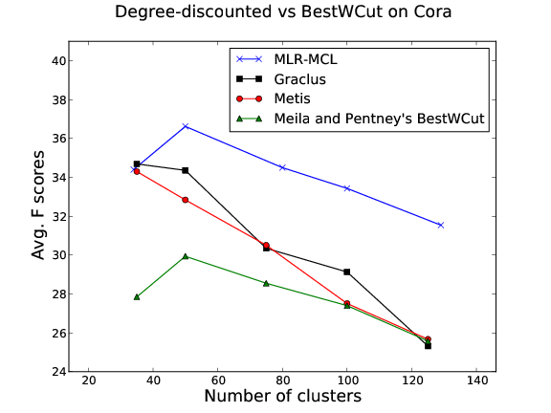
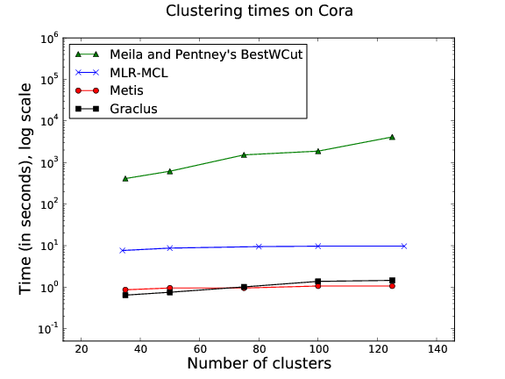
Results on Cora – Comparison with BestWCut
Degree-discounted is 2-3 orders of magnitude faster and also gives higher-quality clusters compared to BestWCut [Meila & Pentney ‘07].

Slide 80
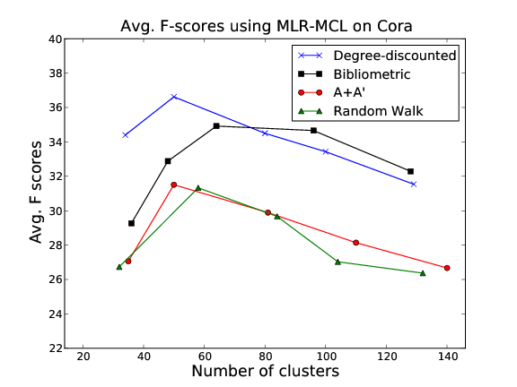
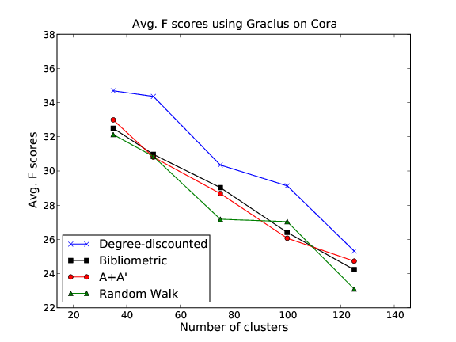
Results on Cora – Comparison of Symmetrizations
Degree-discounted performs the best among all symmetrizations, when used with either MLR-MCL or Graclus.

Slide 81
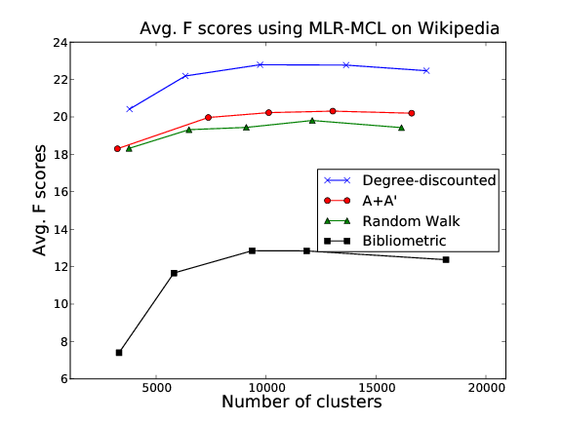
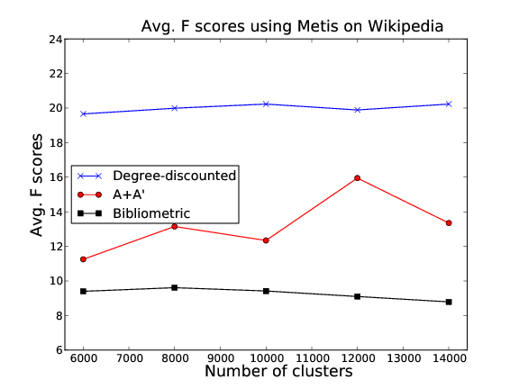
Results on Wikipedia (Quality)
MLR-MCL and Metis show improvements of 12% and 25% on the Degree-discounted graph over the baseline.

Slide 82
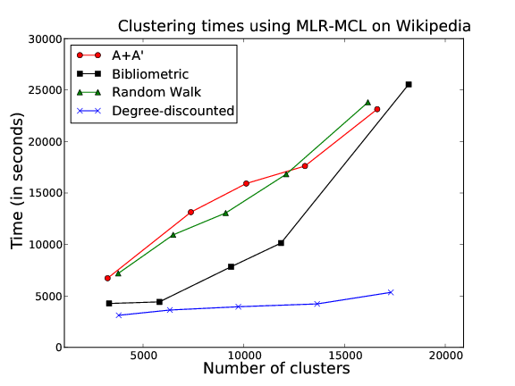
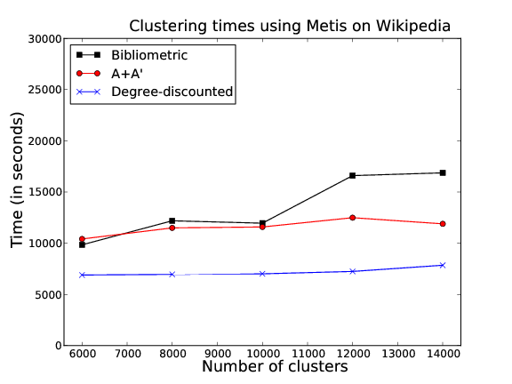
Timing results on Wikipedia
Both MLR-MCL and Metis run 2-4 times faster on Degree-discounted similarity graph.

Slide 83
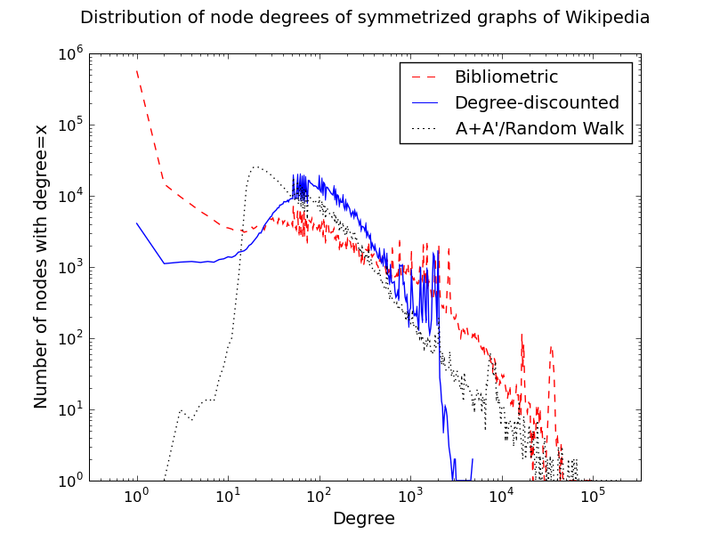
Degree distribution on Wikipedia

Slide 84
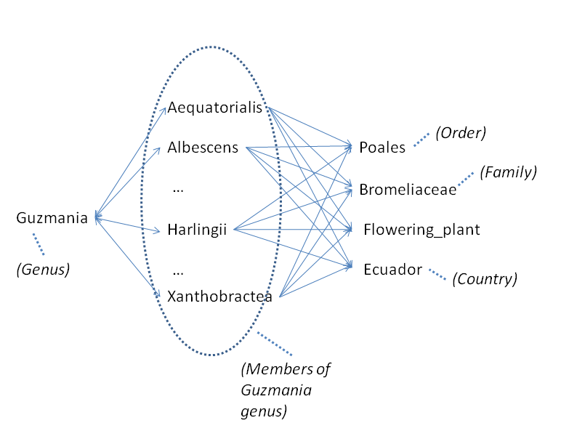
Example Wikipedia cluster

Slide 85
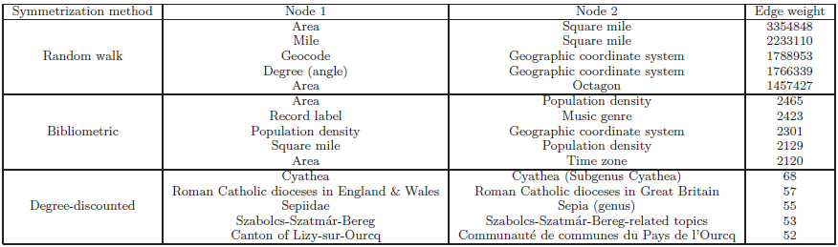
Top similarity pairs in Wikipedia

Slide 86
Testing algorithms
1. Real data w/o gold standards:
2. Read data w/ gold standard
3. Synthetic data
Hard to say which algorithm is the best.
In different scenarios, different algorithms might be best choices.
1 and 2 are practical, but hard to determine which kinds of graphs / clusters an algorithm is suitable.
Sparse/Dense, power-law, overlapping communities.

Slide 87


Real data w/o gold standards
Almeida et al. (2011) discuss many metrics.
Modularity, normalized cut, Silhouette Index, conductance, etc.
Each metric has its own bias.
Modularity, conductance are biased toward small number of clusters.
Should not choose the algorithms which is designed for that metric, e.g. modularity-based method.

Slide 88
Real data w/ gold standard
Examples of gold standard clusters
“Network”tags in Facebook.
Article tags in Wiki
Protein annotations.
Evaluate how closely the clusters are matched to the gold standard.
Cons: Overfitting – biased towards the clustering with similar cluster size.
Cons: Gold standard might be noisy, incomplete.

Slide 89
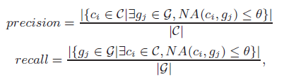
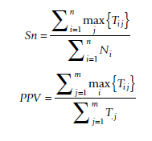
Metrics
F-measure
Harmonic mean of precision and recall
Need a parameter θ (usually 0.25)
Accuracy
Square root of PPV * Sn
T_{ij}: common nodes in community I and cluster j

Slide 90
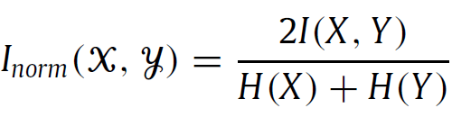
Metrics
Normalized Mutual Information
H(X): Entropy of X
I(X, Y): H(X) – H(X|Y), H(X|Y) is the conditional entropy
Some metrics need to be adjusted for overlapping clustering.
Notes:
From information theory

Slide 91

Synthetic data
Girvan and Newman (2002) Benchmark
Fixed 128 nodes and 4 communities
Can tune noisy level
Cons: All nodes have the same expected degree; All communities have the same size, etc

Slide 92
Synthetic data
LFR (Lancichinetti 2009)
Generate power-law, weighted/unweighted, directed/undirected graph with gold standard
Pros: can generate variaous graphs.
# nodes, average degree, power-law exponent.
Average/Min/Max community size, # bridge nodes.
Noisy level, etc.
Cons: The number of communities each bridge nodes belonging to is fixed.
Use the above metrics to evaluate the result.

